Slide 1
UNIX PROGRAMMING
PART I

Slide 2
Multiprogramming
Multiprogramming
Several jobs from the job pool are kept in memory.
The OS picks and begins execution of one of these jobs.
If the job needs to wait for an I/O device the OS switches to executing another job.
When that job needs to wait the OS switches to another job.
The CPU therefore can be kept busy more of the time.
We say these jobs are being run concurrently.
This is an aspect of operating systems that adds much of its complexity.

Slide 3
Time Sharing
Time Sharing (also called multitasking)
This is an extension of multiprogramming.
No job is allowed to use the CPU for more than a certain time, called the quantum.
A timer is set when a job enters the CPU.
If the timer expires before the job request I/O, another job is chosen for execution.
If the quantum is small compared to a human time scale, it seems as if many jobs are running simultaneously.
This allows for a high degree of interaction between the user and the computer without the associated inefficiency as the CPU waits for the user to push a key.
Similar to when only one person could use a computer at a time. Note: if there is only one CPU, at most one user job can be running at any time.

Slide 4
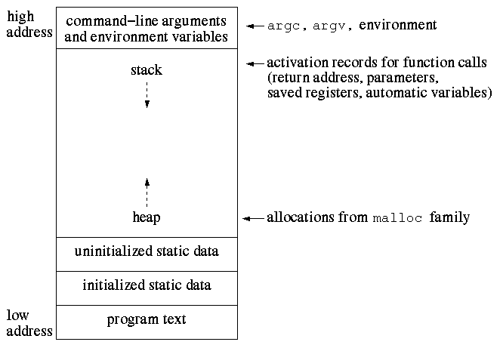
PROGRAM IMAGE

Slide 5
Programs, Processes and Threads
  A program is a prepared sequence of instructions to accomplish a defined task.
  A compiler translates the instructions to produce an executable module.
  When the program is run, the executable module becomes a program image in main memory.
  A process is an instance of a program that is executing.
  A process has an address space and starts with a single flow of control.
  The flow of control executes a sequence of instructions called a thread of execution.
  A thread of execution is a logically related sequence of instruction addresses assigned to the program counter during the execution of a program's code.

Slide 6
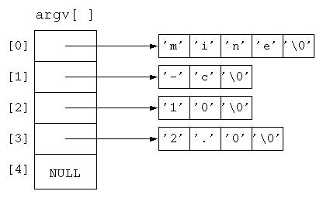

Slide 7
Environment variables
Char *envp[] is used for passing environment variables during exec family of calls
main(int argc,char *argv[],char *envp[])
{
…
}

Slide 8
GCC basics
gcc file1.c –o file1
gcc file1.c (a.out)
gcc –c file1.c –o file1.o
gcc –g file1.c –o file1
gcc –O file1.c –o file1
(many more combinations are possible)

Slide 9
Process creation
fork:
#include <sys/types.h>
#include <unistd.h>
pid_t fork(void);
return -1 if error
return 0 to child
return child's pid to parent

Slide 10
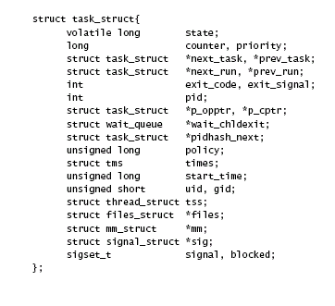

Slide 11
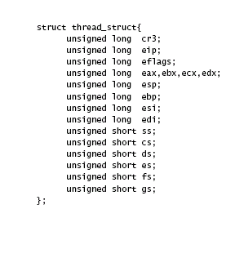

Slide 12
Assignment
Create a fan of processes
Create a chain of processes

Slide 13
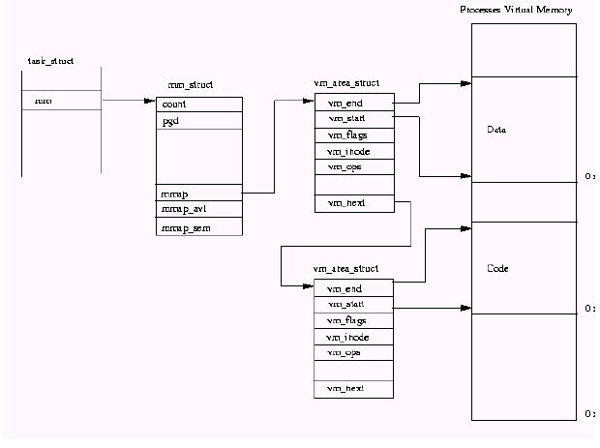

Slide 14
Assignment continued
Trace the following program segment and determine how many processes are created. Assume that no errors occur. Draw a graph that shows how the processes are related. In this graph each process will be represented by a small circle containing a number that represents which fork created the process. The original process will contain 0 and the process created by the first fork will contain 1. There will be arrows from each parent to all of its children. Each arrow should point in a downward direction.
c2 = 0;
c1 = fork(); /* fork number 1 */
if (c1 == 0) c2 = fork(); /* fork number 2 */
fork(); /* fork number 3 */
if (c2 > 0) fork(); /* fork number 4 */

Slide 15
Parent waits for child(ren)
wait:
#include <sys/wait.h>
pid_t wait(int *stat_loc);
If a child terminated, return its pid
Otherwise return -1 and set errno

Slide 16
Parent waits for Child(ren)..
pid_t waitpid(pid_t pid, int *stat_loc, int options); wait:
If a child terminated, return its pid
Otherwise return -1 and set errno waitpid:
Allows you to wait for a particular process, or all process if pid is -1. Important option is NOHANG which will return 0 if there is a specified child to wait for but it has not yet terminated.

Slide 17
Parent waits for child(ren)…
Important values of errno:
ECHILD no unwaited for children
EINTR a signal was caught
The status value is 0 if and only if the process terminated normally and returned 0. In all other cases the status should be examined using the provided macros defined in sys/wait.h.

Slide 18
Parent waits for child(ren)
The following code segments waits for all children that have finished but does not block if there are no children whose status is available:
pid_t childpid;
while (childpid = waitpid(-1,NULL,WNOHANG))
if ((childpid == -1) && (errno != EINTR)) break;

Slide 19
Exit status from wait
Status values
The following macros are available for checking the return status of a child:
#include <sys/wait.h>
WIFEXITED(int stat_val)
WEXITSTATUS(int stat_val)
WIFSIGNALED(int stat_val)
WTERMSIG(int stat_val)
WIFSTOPPED(int stat_val)
WSTOPSIG(int stat_val)
They are used in pairs.If WIFEXITED returns true, the child executed normally and the return status (8 bits) can be gotten with WEXITSTATUS

Slide 20
Process Characteristics
Each process has a unique process id
Process id non-negative
Each process has a parent
Each process can determine parent id
Process with pid = 1 (init process) is
the ancestor for all processes
init adopts orphaned processes
Init waits for orphaned zombies as well

Slide 21
Process characteristics..
Each process has an environment
Each process is associated with uid,gid,euid,egid
Each process is asscociated with current working directory
Each process has pid, ppid and pgid

Slide 22
Process support calls
#include <sys/types.h>
#include<unistd.h>
pid_t getpid()
pid_t getppid(void)
pid_t getpgid(pid_t pid)
pid_t setpgid(pid_t pid, pid_t pgid)

Slide 23
Copy-on-write
Modern systems do create a copy of Data pages shared between parent or child until
one of the processes(parent or child) writes to the page
Please demonstrate this with code

Slide 24
Process termination
Exit/return/ fall through
A process’s parent is notified when a child terminates(SIGCHLD – default ignored)
Its child processes are assigned to init

Slide 25
Process image overlay - exec
Exec is a family of similar functions that do the following :
Replace current process image with a new one
Do not return if successful
Same process and pid
Inherit many properties before exec
Supports a wide range of functions based
on execve() system call

Slide 26
Exec family of calls
exec
#include <unistd.h>
extern char **environ;
int execl(const char *path, const char *arg0, ... /*, char *(0) */);
int execle (const char *path, const char *arg0, ... /*, char *(0), char *const envp[] */);
int execlp (const char *file, const char *arg0, ... /*, char *(0) */);
int execv(const char *path, char *const argv[]);
int execve (const char *path, char *const argv[], char *const envp[]);
int execvp (const char *file, char *const argv[]);

Slide 27
Attributes inherited after fork() and after exec()
Please find the attributes inherited after fork() ( not inherited as well)
Please find the attributes inherited after
exec() (not inherited as well)

Slide 28
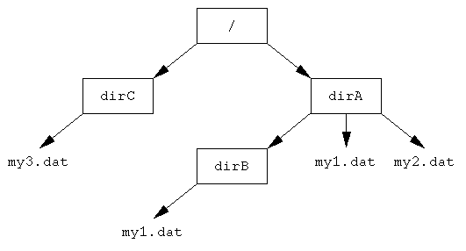
File basics

Slide 29
Process / cwd
Current Working Directory
#include <unistd.h>
int chdir(const char *path);
char *getcwd(char *buf, size_t size);
outputs the pathname of the current working directory. It uses PATH_MAX to determine the size of the buffer needed.

Slide 30
Accessing file information
Accessing file status information
#include <sys/stat.h>
int lstat(const char *restrict path, struct stat *restrict buf);
int stat(const char *restrict path, struct stat *restrict buf);
int fstat(int fildes, struct stat *buf);

Slide 31
Mode field / type of file
S_ISBLK(m) block special file
S_ISCHR(m) character special file
S_ISDIR(m) directory
S_ISFIFO(m) pipe or FIFO special file
S_ISLNK(m) symbolic link
S_ISREG(m) regular file
S_ISSOCK(m) socket

Slide 32
Accessing file information..
stat is given the name of a file.
fstat is used for open files.
lstat does the same thing as stat except that if the file is a symbolic link, it gives information about the link, rather than the file it is linked to.

Slide 33
Stat structure
The contents of the struct stat are system dependent, but the standard says that it must contain at least the following fields:
dev_t st_dev; /* device ID of device containing file */
ino_t st_ino; /* file serial number */
mode_t st_mode; /* file mode */
nlink_t st_nlink; /* number of hard links */
uid_t st_uid; /* user ID of file */
gid_t st_gid; /* group ID of file */
off_t st_size; /* file size in bytes (regular files) */
/* path size (symbolic links) */
time_t st_atime; /* time of last access */
time_t st_mtime; /* time of last data modification */
time_t st_ctime; /* time of last file status change */

Slide 34
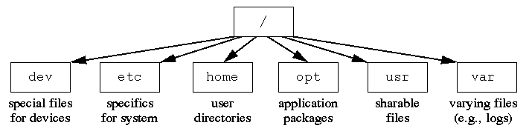
Unix hierarchy

Slide 35
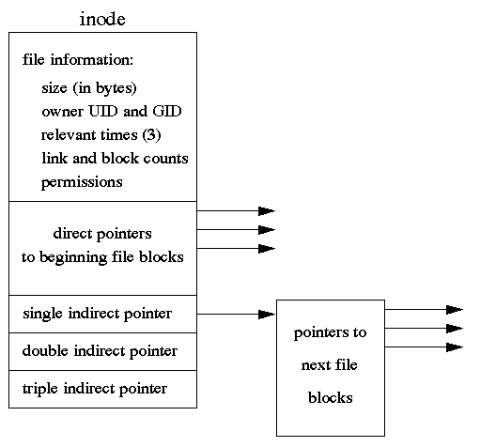

Slide 36
Links
  A link is an association between a filename and an inode.
  UNIX has two types of links: hard and symbolic (also called
  soft).
  Directory entries are called hard links because they directly link
  filenames to inodes.
  Each inode contains a count of the number of hard links to the
  inode.
  When a file is created, a new directory entry is created an a new
  inode is assigned.
  Additional hard links can be created with
  ln newname oldname or with the link system call.
  A new hard link to an existing file creates a new directory entry
  but assigns no other additional disk space.
  A new hard link increments the link count in the inode.
  A hard link can be removed with the rm command or the unlink
  system call.
  These decrement the link count.
  The inode and associated disk space are freed when the count is
  decremented to 0.

Slide 37
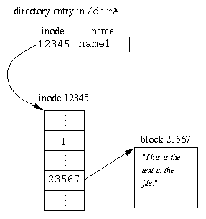

Slide 38
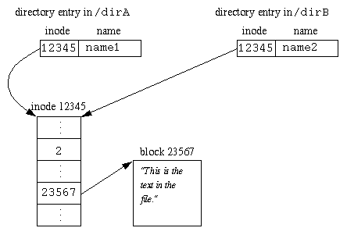

Slide 39
Assignments
What would happen to the above diagram after the following sequence of operations:
open("/dirA/name1");
read
close
modify memory image of the file
unlink("/dirA/name1");
open("/dirA/name1");
write
close
Answer: ?

Slide 40
Assignments..
Some editors make a backup copy of the file being edited. One way to do this is with the following:
open("/dirA/name1");
read
close
modify memory image file file
rename("/dirA/name1","dirA/name1.bak");
open("/dirA/name1");
write
close
Answer ?

Slide 41
Symbolic links or soft links
Symbolic Links
A symbolic link is a special type of fie that contains the name of another file.
A reference to the name of a symbolic link causes the operating system to use the name stored in the file, rather than the name itself.
Symbolic lines are created with the command:
ln -s newname oldname or symlink() system call
Symbolic links do not affect the link count in the inode.
Unlike hard links, symbolic links can span filesystems.

Slide 42
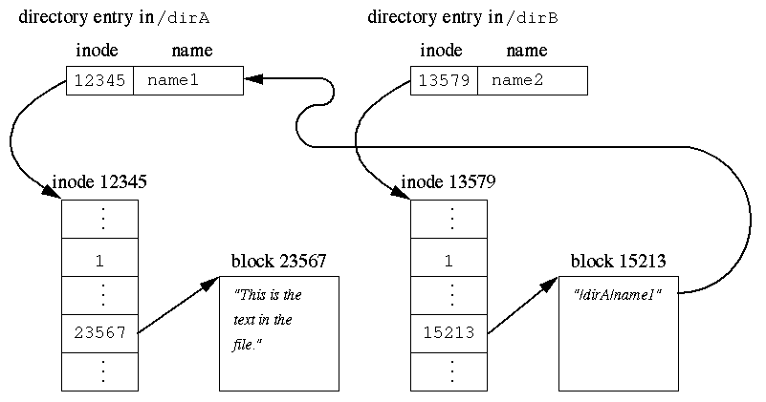
Symbolic links or soft links..

Slide 43
UNIX I/O
Unix uses device independence.
I/O is done through device drivers that have a standard interface.
5 main system calls for I/O:
open ,close ,read ,write ,ioctl
These calls return -1 on error and set errno UNIX I/O is done with file descriptors.
Normally, when your program starts, there are 3 file descriptors open:
STDIN_FILENO, STDOUT_FILENO,
STDERR_FILENO

Slide 44
Open system call
open
#include <fcntl.h>
#include <sys/stat.h>
int open(const char *path, int oflag);
int open(const char *path, int oflag, mode_t mode);
Possible values of the flag include:
O_RDONLY: read only
O_WRONLY: write only
O_RDWR: read and write
O_APPEND: writes always write to end
O_CREAT: create the file if it does not exist
O_EXCL: used with O_CREAT, return an error if file exists
NONBLOCK: do not block if not ready to open, also affects reads and writes
O_TRUNC: discard previous contents You must use the 3-parameter form of open if the O_CREAT flag is used. This specifies permissions

Slide 45
Read system call
read
#include <unistd.h>
ssize_t read(int fildes, void *buf, size_t nbyte);
size_t is an unsigned integral type.
ssize_t is a signed integral type.
this can return fewer bytes than requested.
you must allocate a buffer to hold the bytes read.
a return value of -1 with errno set to EINTR is not usually an error.

Slide 46
Write system call
write
#include <unistd.h>
ssize_t write(int fildes, const void *buf, size_t nbyte);
It is not an error if this returns a value greater than 0 and less than nbyte
You must restart the write if it returns fewer bytes than requested.
a return value of -1 with errno set to EINTR is not usually an error.

Slide 47
Close system call
#include <unistd.h>
int close(int fildes);
Open files are closed when your program exits normally

Slide 48
File Representation
The File Descriptor Table is part of the user program area and can be thought of as an array of pointers indexed by the file descriptors.
The pointers point to entries in the System File Table.
The System File Table is in the kernel area.
It contains an entry for each open file.
Entries contain pointers to a table of inodes kept in memory.
Entries contain other information including the current file offset and a count of the number of file descriptors that are using this entry.
When a file is closed the count is decremented. The entry is freed when the count becomes 0.
The In-Memory Inode Table contains copies of the inodes that are being used.

Slide 49
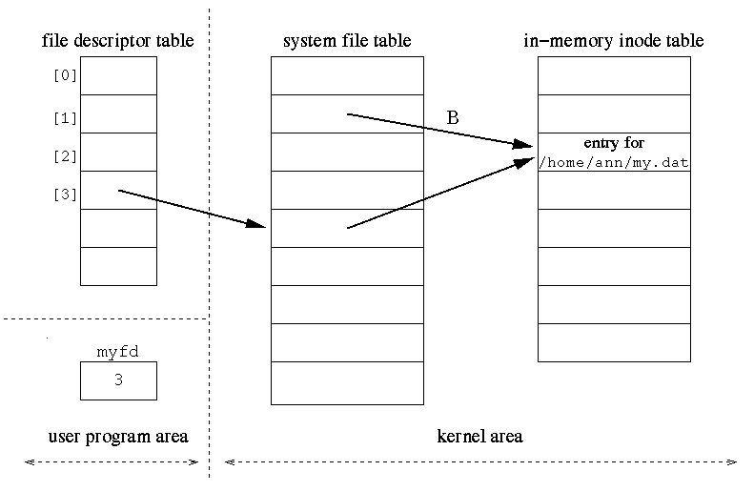

Slide 50
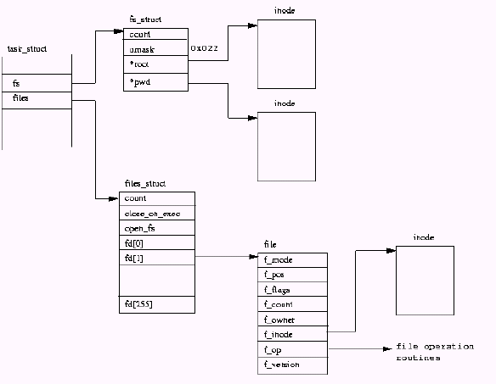

Slide 51
Standard I/O library
File Pointers and Buffering
Use fopen, fclose, fread, fwrite, fprintf, fscanf, etc.
FILE *myfp;
if ((myfp = fopen("/home/ann/my.dat", "w")) == NULL)
perror("Failed to open /home/ann/my.dat"); else fprintf(myfp, "This is a test");

Slide 52
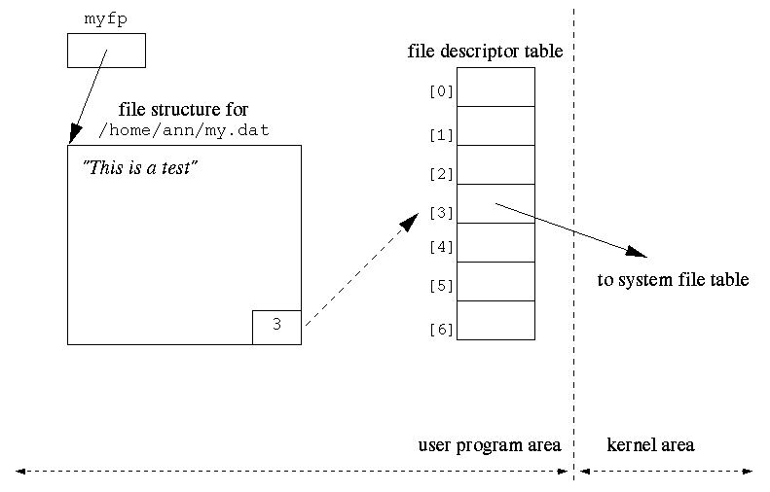

Slide 53
How does it work ?
I/O using file pointers will read from or write to the buffer.
The buffer will be filled or emptied when necessary.
A write may fill part of the buffer without causing any physical I/O to the file.
The amount of buffer may vary.
If a write is done to standard output and them the program crashes, the data written may not show up on the screen.
Standard error is not buffered.
Interleaving output to standard output and standard error may cause output to appear in an unpredictable order.
You can force the physical output to occur with an fflush.

Slide 54
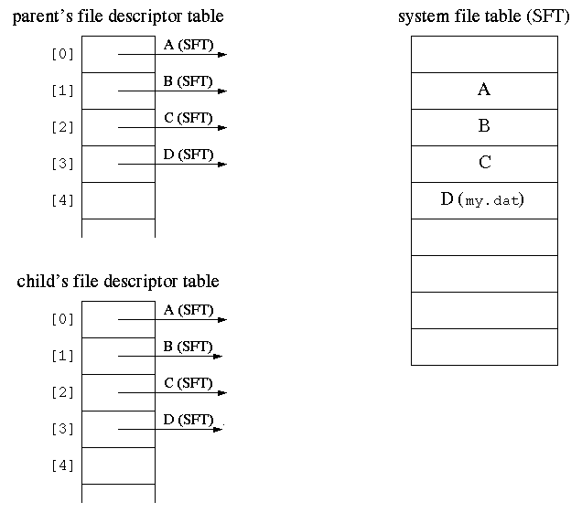
Inheritance of file descriptor tables

Slide 55
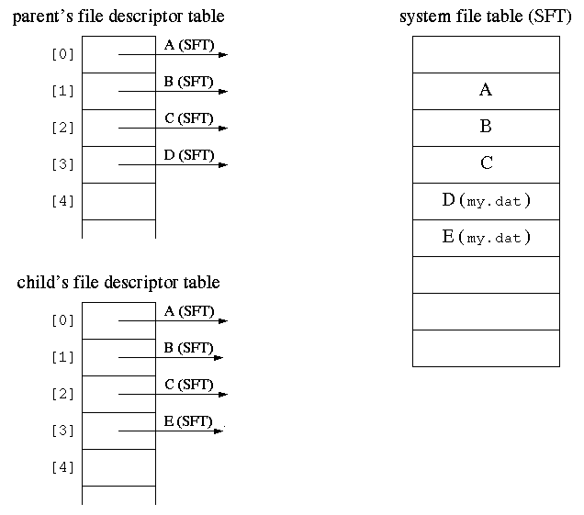
Inhertiance of file descriptor tables..

Slide 56
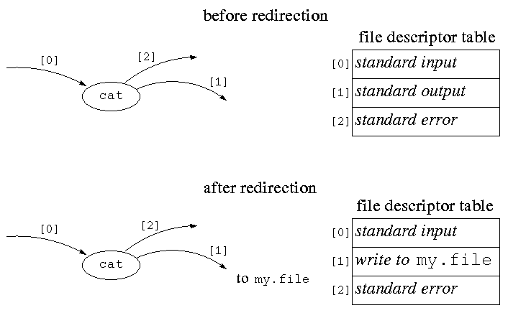
File redirection(cat > my.file)

Slide 57
Redirection using dup2()
Redirection can be done by copying one entry of the file descriptor table into another.
This is accomplished with the dup2 system call.
#include <unistd.h>
int dup2(int fildes, int fildes2);
It closes fildes2 and then copies the pointer of entry fildes into the entry fildes2

Slide 58
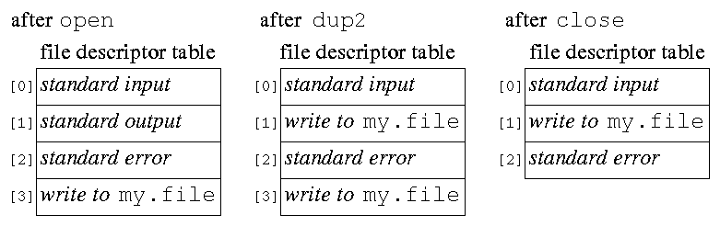
How dup2() works ?

Slide 59
Pipe() system call (ls | wc)
This is implemented with the pipe system call:
#include <unistd.h>
int pipe(int fildes[2]);
This creates a communication buffer that the caller can access through file descriptors fildes[0] and fildes[1].
The data written to fildes[1] is read from fildes[0] on a first-in-first-out bases.
The pipe has no external or permanent name and can only be accessed through its two file descriptors.
The pipe can only be used by the process that created it and its descendents.

Slide 60
Assignment
Using pipe() system call and redirection methods discussed earlier, implement
ls | wc
execute and test if it works as expected

Slide 61
Named pipes
FIFOs
FIFOs, or named pipes allow you to use pipes between processes that are not related.
You can create a named pipe with the mkfifo command or the mkfifo system call.
#include <sys/stat.h>
int mkfifo(const char *path, mode_t mode);

Slide 62
Pipes and client/server model
In the client-server model of communication:
A server process waits for requests from clients.
Client processes request service from a server.
A process can act as both a client and a server
Important property of pipes and FIFOs:
A write of at most PIPE_BUF bytes to a pipe or FIFO is atomic.
Note that reads are not necessarily atomic.

Slide 63
Assignment
Illustrate with a suitable example how named pipe can be used for client/server model ! Do you expect problems !

Slide 64
Signals :
A signal is generated when the event that causes the signal occurs.
A signal is delivered when the process takes action based on the
signal.
The lifetime of a signal is the interval between its generation and
delivery.
A signal that has been generated but not yet delivered is pending.
A process catches a signal if it executes a signal handler when the
signal is delivered.
Alternatively, a process can ignore as signal when it is delivered,
that is to take no action.
The function sigaction is used to specify what is to happen to a
signal when it is delivered.
The signal mask determines the action to be taken when the signal is
generated. It contains a list of signals to be blocked.
A blocked signal is not delivered to a process until it is unblocked.
The function sigprocmask is used to modify the signal mask.
Each signal has a default action which is usually to terminate.

Slide 65
Most common signals
SIGINT SIGUSR1
SIGTERM SIGUSR2
SIGQUIT SIGILL
SIGSEGV SIGHUP
SIGABRT SIGPIPE
SIGCHLD SIGKILL
SIGSTOP
SIGCONT
SIGTSTP

Slide 66
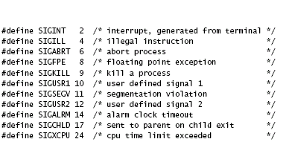

Slide 67
Sending signals from command line
You can send a signal to a process from the command line using kill
kill -l will list the signals the system understands
kill [-signal] pid will send a signal to a process.
The optional argument may be a name or a number.The default is SIGTERM.
To unconditionally kill a process, use:
kill -9 pid which is
kill -KILL pid.

Slide 68
From a program you can use the kill system call:
#include <sys/types.h>
#include <signal.h> int kill(pid_t pid, int sig); if (kill(3423, SIGUSR1) == -1) perror("Failed to send the SIGUSR1 signal"); a child kills its parent: if (kill(getppid(), SIGTERM) == -1) perror ("Failed to kill parent"); a process sends a signal to itself: if (raise(SIGUSR1) != 0) perror("Failed to raise SIGUSR1"); kill an infinite loop after 10 seconds: int main(void){ alarm(10); for ( ; ; ) ; }

Slide 69
Signal handling calls
Signal Mask and Signal Sets
How do you deal with a set of signals?
Originally, an int would hold a collection of bits, one per signal.
Now, signal sets of type sigset_t are used.

Slide 70
Signal handling calls ..
#include <signal.h>
int sigemptyset(sigset_t *set);
int sigfillset(sigset_t *set);
int sigaddset(sigset_t *set, int signo);
int sigdelset(sigset_t *set, int signo);
int sigismember(const sigset_t *set, int signo);
sigemptyset initializes the set to contain no signals
sigfillset puts all signals in the set
sigaddset adds one signal to the set
sigdelset removes one signal from the set
sigismember tests to see if a signal is in the set

Slide 71
Signal handling calls …
The process signal mask is a set of signals that are blocked.
A blocked signal remains pending after it is generated until the signal is unblocked.
The process signal mask is modified with the sigprocmask system call.
#include <signal.h>
int sigprocmask(int how, const sigset_t *restrict
set, sigset_t *restrict oset); The how can be:
SIG_BLOCK
SIG_UNBLOCK
SIG_SETMASK
Either set or oset may be NULL.

Slide 72
Signal handling call ….
initialize a signal set:
if ((sigemptyset(&twosigs) == -1) || (sigaddset(&twosigs, SIGINT) == -1) || (sigaddset(&twosigs, SIGQUIT) == -1))
perror("Failed to set up signal mask");

Slide 73
Signal handling calls …..
add SIGINT to the set of blocked signals:
sigset_t newsigset;
if ((sigemptyset(&newsigset) == -1) || (sigaddset(&newsigset, SIGINT) == -1))
perror("Failed to initialize the signal set");
else if (sigprocmask(SIG_BLOCK, &newsigset, NULL) == -1)
perror("Failed to block SIGINT");

Slide 74
Sigaction
Catching and Ignoring Signals: sigaction
#include <signal.h>
int sigaction(int signo, const struct sigaction *act, struct sigaction *oact);
struct sigaction {
void (*sa_handler)(int); /* SIG_DFL, SIG_IGN or
pointer to function */
sigset_t sa_mask; /* additional signals to be blocked
during execution of handler */
int sa_flags; /* special flags and options */
….
} Note : Either act or oact may be NULL

Slide 75
Sigaction ...
If the SA_SIGINFO flag of the sa_flags field is clear, sa_handler specifies the action to be taken
void (*sa_handler)() means a pointer to a function that has not return value.

Slide 76
Sigaction …
ignore SIGINT if the default action is set:
struct sigaction act;
if (sigaction(SIGINT, NULL, &act) == -1)
/* Find current SIGINT handler */
perror("Failed to get old handler for SIGINT");
else if (act.sa_handler == SIG_DFL) {
/* if SIGINT handler is default */
act.sa_handler = SIG_IGN;
/* set new SIGINT handler to ignore */
if (sigaction(SIGINT, &act, NULL) == -1)
perror("Failed to ignore SIGINT"); }

Slide 77
Sigaction ….
set up a signal handler for SIGINT:
void catchctrlc(int signo) {
char handmsg[] = "I found Ctrl-C\n";
int msglen = sizeof(handmsg);
write(STDERR_FILENO, handmsg, msglen);
} ...
struct sigaction act;
act.sa_handler = catchctrlc;
act.sa_flags = 0;
if ((sigemptyset(&act.sa_mask) == -1) || (sigaction(SIGINT,
&act, NULL) == -1))
perror("Failed to set SIGINT to handle Ctrl-C");

Slide 78
Sigaction …..
set the action of SIGINT to the default:
struct sigaction newact;
newact.sa_handler = SIG_DFL;
/* new handler set to default */
newact.sa_flags = 0;
/* no special options */
if ((sigemptyset(&newact.sa_mask) == -1) || (sigaction(SIGINT, &newact, NULL) == -1))
perror("Failed to set SIGINT to the default action");

Slide 79
Waiting for signals
Waiting for signals
Old way: pause
#include <unistd.h>
int pause(void);
an incorrect way to wait for a signal:
static volatile sig_atomic_t sigreceived = 0;
while(sigreceived == 0) pause();
Assignment : analyse what is wrong ?

Slide 80
Waiting for signals ..
another incorrect way to wait for a signal:
static volatile sig_atomic_t sigreceived = 0;
int signum;
sigset_t sigset;
sigemptyset(&sigset);
sigaddset(&sigset, signum);
sigprocmask(SIG_BLOCK, &sigset, NULL);
while(sigreceived == 0) pause();
Assignment : Analyse what is wrong ?

Slide 81
Waiting for signals …
What you need to do: atomically unblock the signal and suspend the process.
#include <signal.h>
int sigsuspend(const sigset_t *sigmask);
Sets the signal mask to the one pointed to by sigmask and suspends the process until a signal is received.
When it returns the signal mask is restored to what it was before it was called.
This function always returns -1.

Slide 82
Waiting for signals ….
a correct way to wait for a signal:
static volatile sig_atomic_t sigreceived = 0;
sigset_t maskblocked, maskold,maskunblocked;
int signum = SIGUSR1;
sigprocmask(SIG_SETMASK, NULL,
&maskblocked);
sigprocmask(SIG_SETMASK, NULL,
&maskunblocked);
sigaddset(&maskblocked, signum); 9.
sigdelset(&maskunblocked, signum); 10.
sigprocmask(SIG_BLOCK, &maskblocked,
&maskold);
while(sigreceived == 0)
sigsuspend(&maskunblocked); sigprocmask(SIG_SETMASK, &maskold, NULL);

Slide 83
Assignments
Install signal handlers and analyse how the pause() and sigsuspend() work
Also, please write a signal handler that will wait for its children inside the signal handler everytime a SIGCHLD is received
without blocking; (difficult )

Slide 84
Three issues in handling signals
Certain blocking system calls will return -1 with errno set to EINTR if a signal is caught while the function is blocked.
See the man page to see of a system call can set errno to EINTR.
In this case you should usually restart the function since a real error has not occurred.

Slide 85
Three issues in handling signals..
2. Handling errors in signal handlers.
If you use a function that can modify errno in a signal handler, you must make sure that it does not interfere with error handling in the main part of the program.
There is only one errno and it is used by both the main program and by the signal handler.
Solution: in the signal handler, save and restore errno.
void myhandler(int signo) {
int esaved;
esaved = errno;
write(STDOUT_FILENO, "Got a signal\n", 13);
errno = esaved;
}

Slide 86
Three issues in handling signals…
3. Async-signal safety.
Only certain system calls and library functions may be used safely in a signal handler.
The strtok function is an example of a function that might have a problem.
In fact, the POSIX standard only graruantees that a small number of functions are async-signal safe, that is safe to use in a signal handler and the main program.
Other functions may be async-signal safe in some implementations.
Almost none of the functions in the standard C library are on the list.

Slide 87
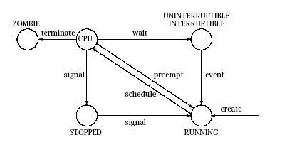

Slide 88
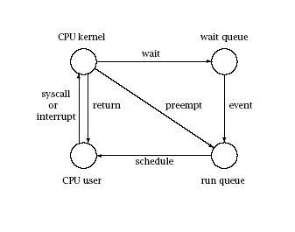

Slide 89
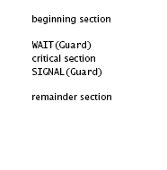
SEMAPHORE

Slide 90


Slide 91
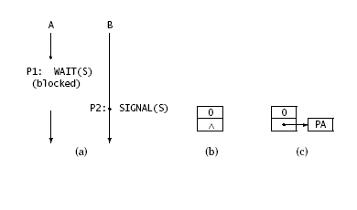

Slide 92
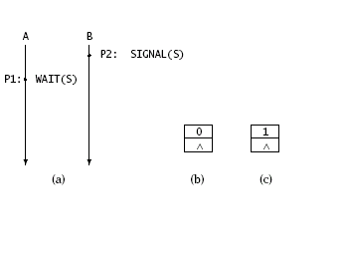

Slide 93
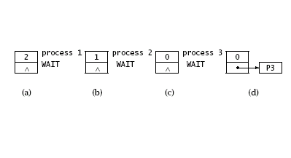
COUNTING SEMAPHORE

Slide 94
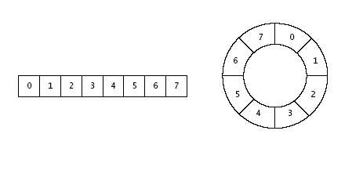
Circular(ring) buffer

Slide 95
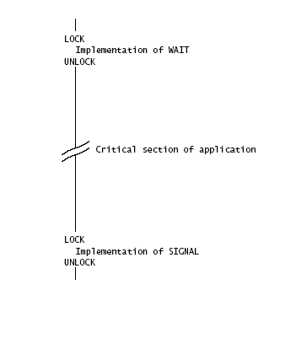
Semaphore implementation

Slide 96
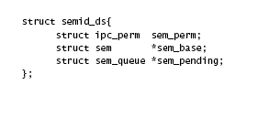
System V semaphore

Slide 97
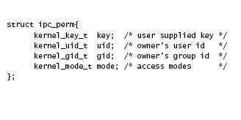
System V semaphores ..

Slide 98

System V semaphore …

Slide 99
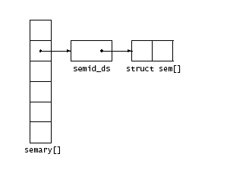
System V semaphore ….

Slide 100
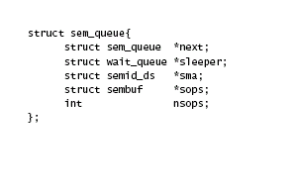
System V semaphore …..

Slide 101
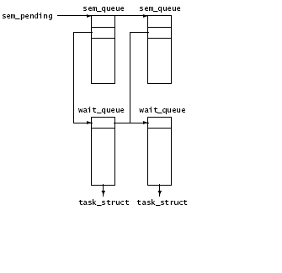
System V semaphore ……

Slide 102
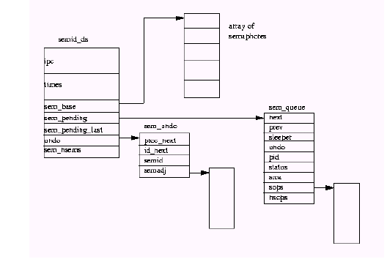

Slide 103
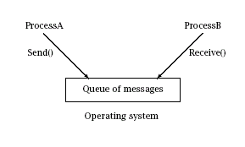
System V message queues

Slide 104
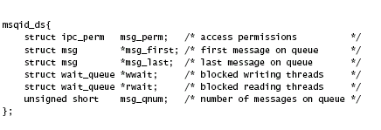
System V message queues..

Slide 105
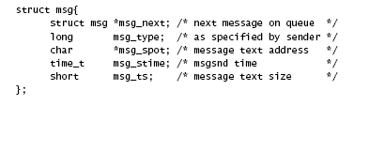
System v message queues …

Slide 106
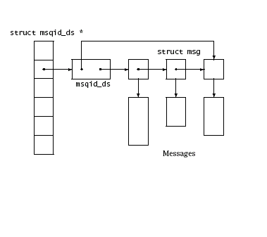
System V message queues ….

Slide 107
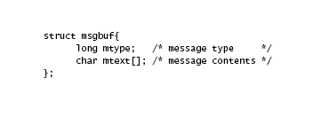
System V message queues …..

Slide 108
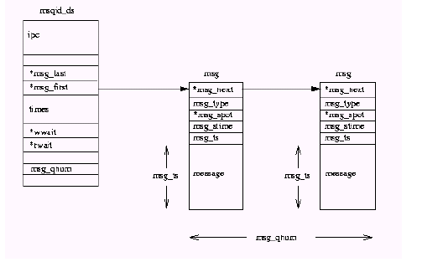

Slide 109
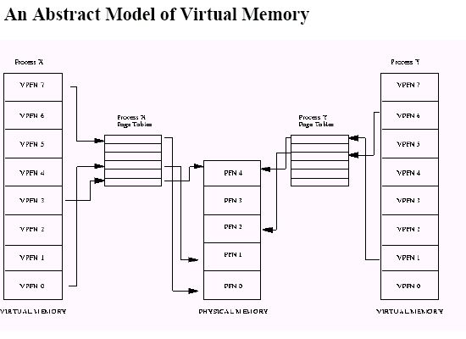

Slide 110
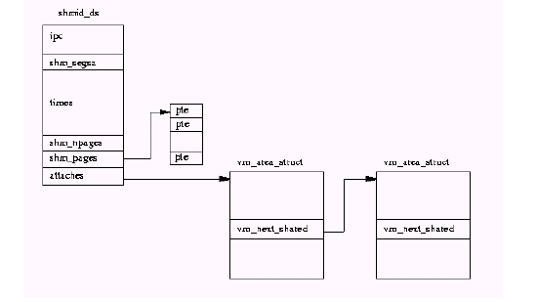
System V shared memory

Slide 111
System V ipc API
Semget()/shmget()/msgget()
Semctl/shmctl()/msgctl()
Semop
Msgsnd()/msgrcv()
Key/id
Persistent after the process dies
May be removed by ipcrm

Slide 112
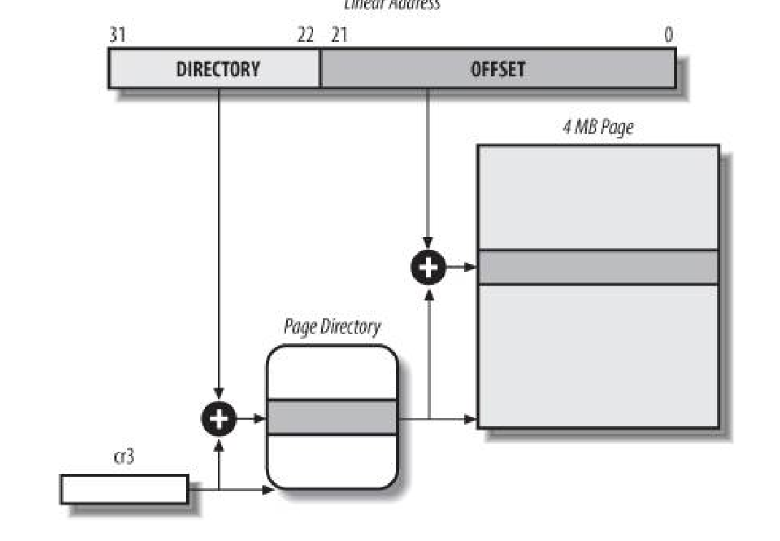

Slide 113
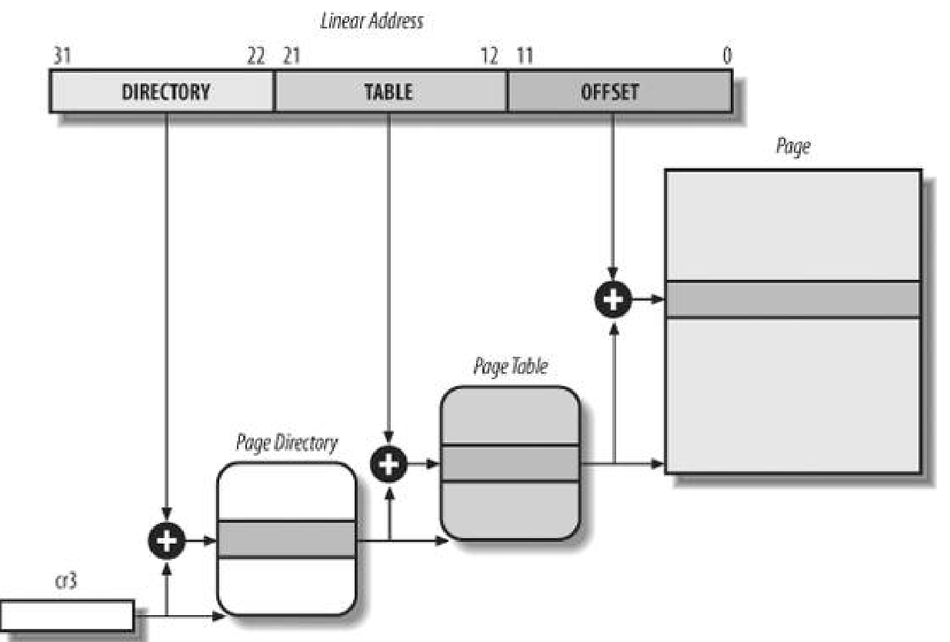

Slide 114
